Slide 1

Seeing the Future: The Evolution and Impact of Computer Vision
How machines learned to see — and why it's transforming every industry on Earth.
Mohammed Afnan
192421317

Slide 2
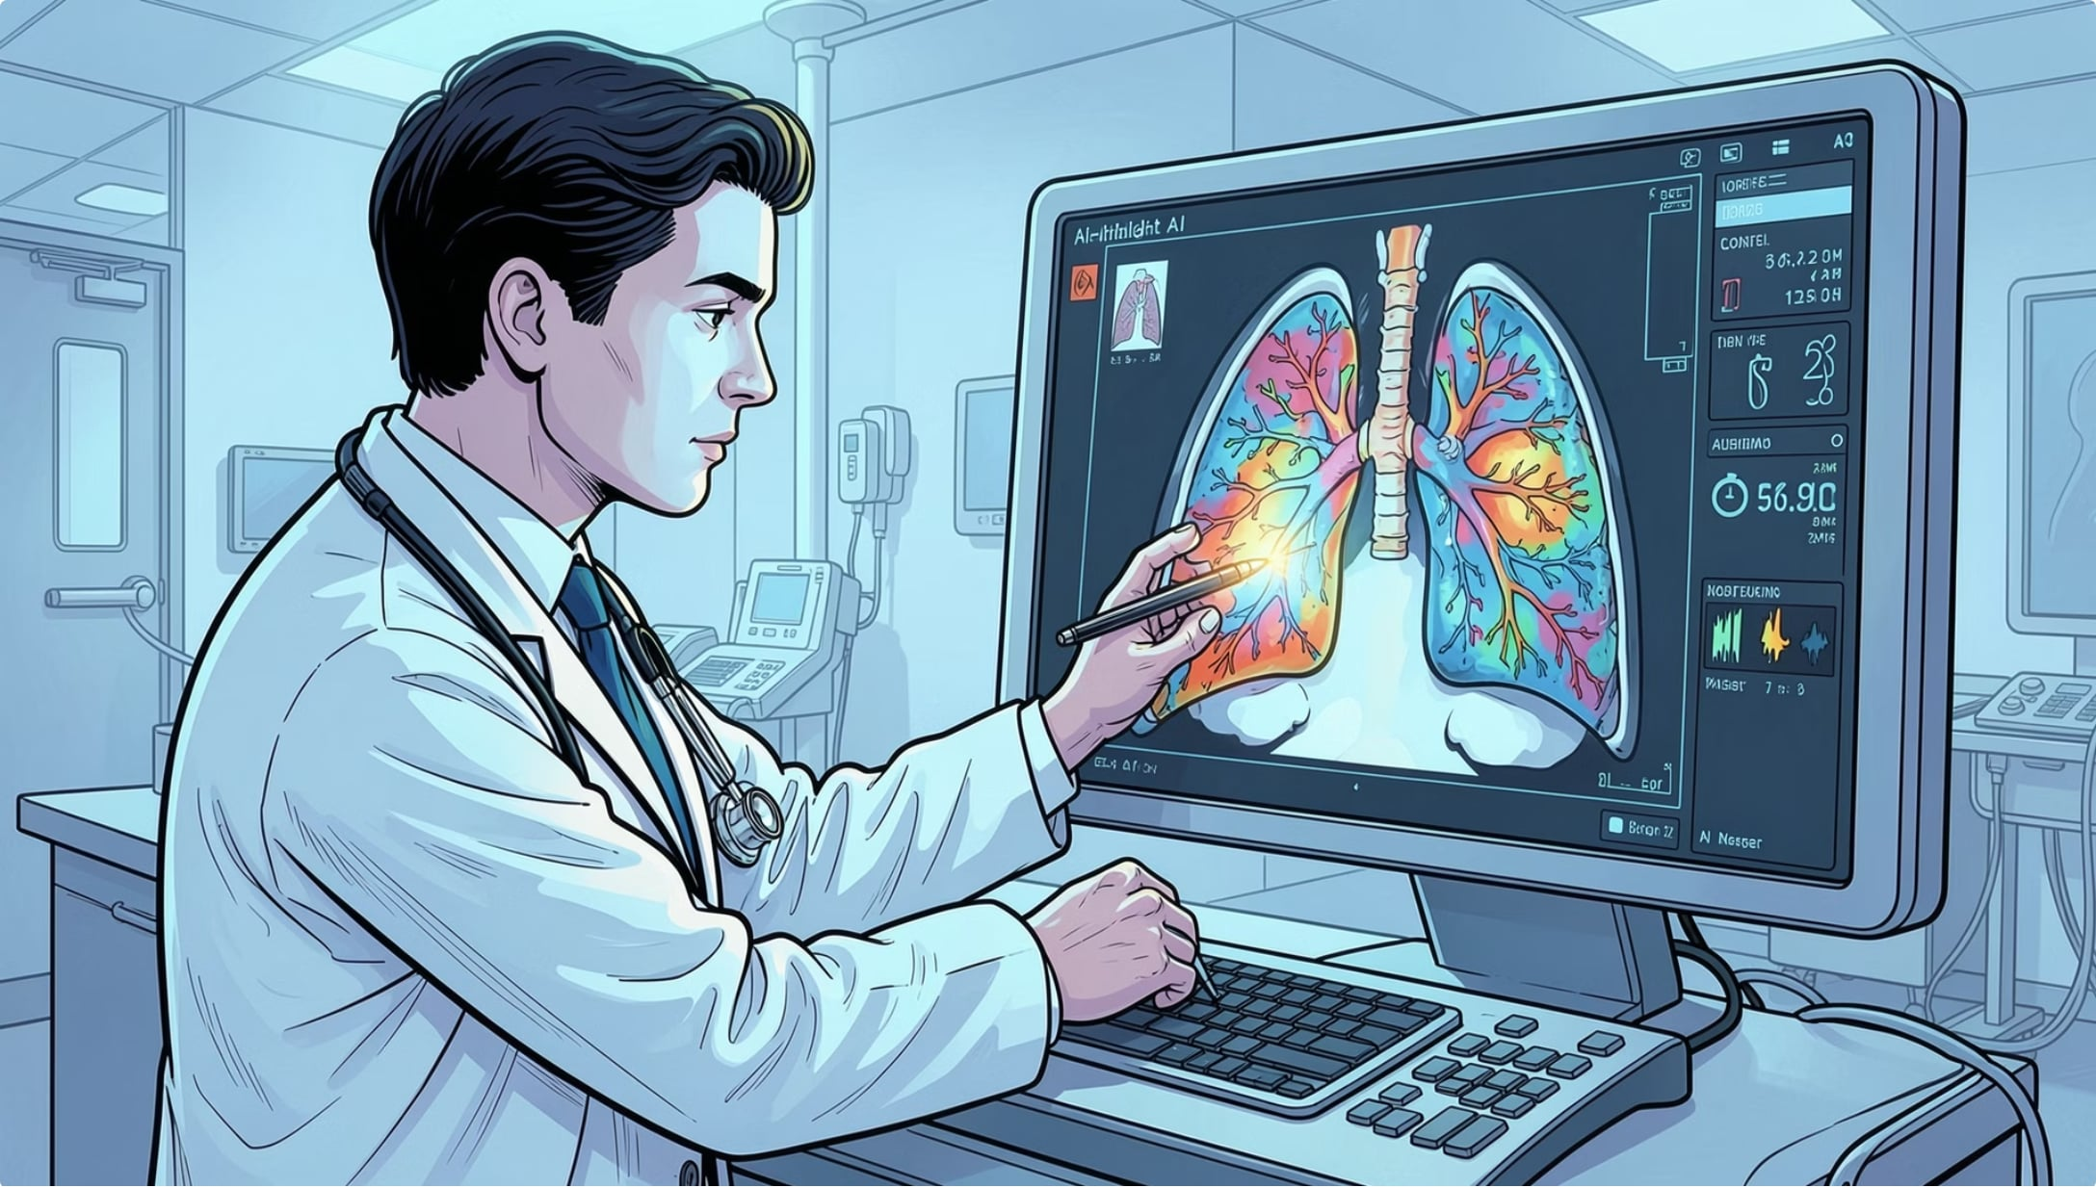
Healthcare & Agriculture: Saving Lives and Crops
HEALTHCARE
AI-Powered Diagnostics
Computer vision detects tumours in X-rays and MRI scans with accuracy surpassing human radiologists, dramatically reducing diagnostic time and error rates.
AGRICULTURE
Precision Farming
Drones and cameras monitor crop health, identify pest infestations, and automate irrigation — boosting yields while cutting water and chemical waste by up to 30%.

Slide 3
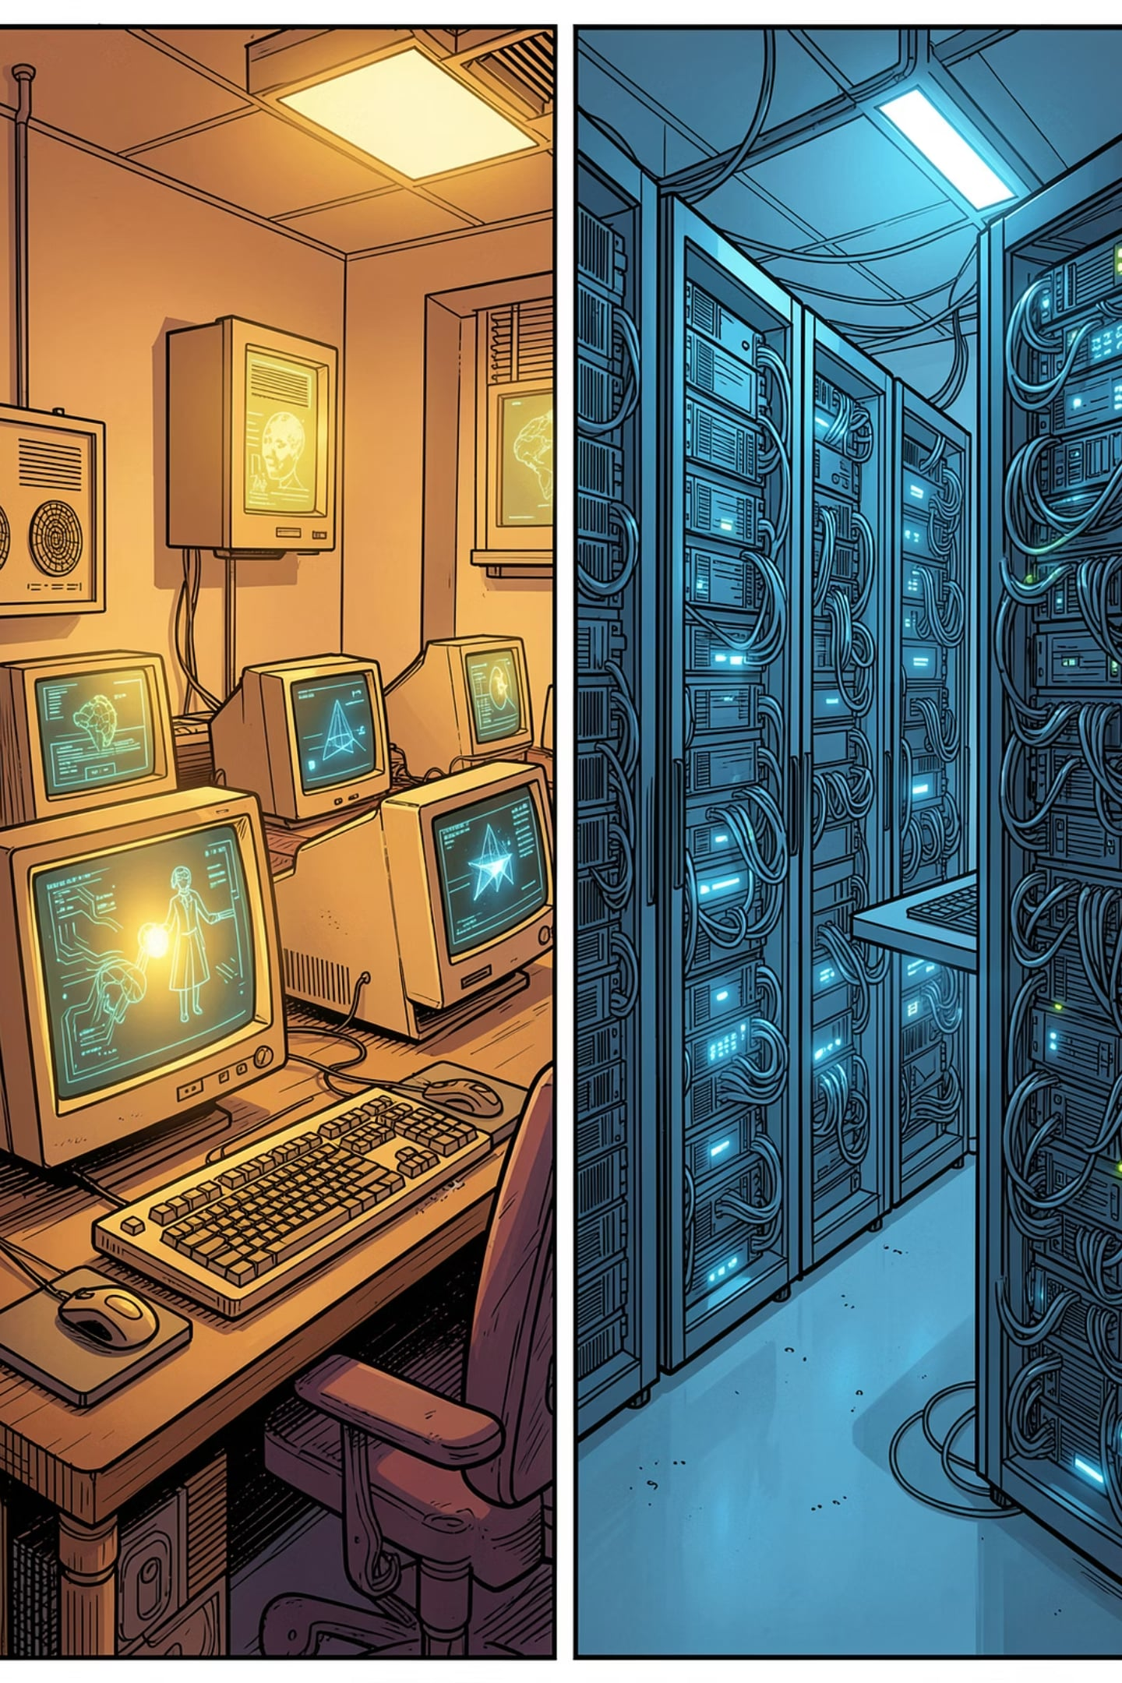
From Early Logic to Modern Intelligence
1
1960s
Foundations laid in medical imaging and basic pattern recognition — the first machines that could "see."
2
1970s
Algorithms moved beyond labs into remote sensing and astronomy, expanding real-world applications.
3
2010s–Today
Deep learning models like ResNet and YOLO enable real-time, large-scale visual analysis across industries.

Slide 4
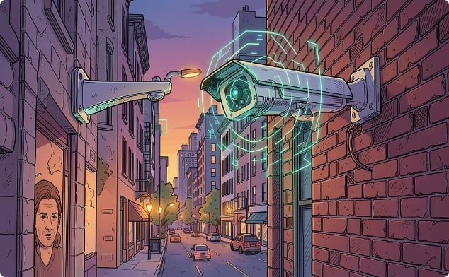
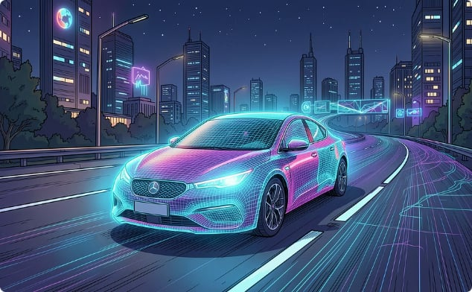
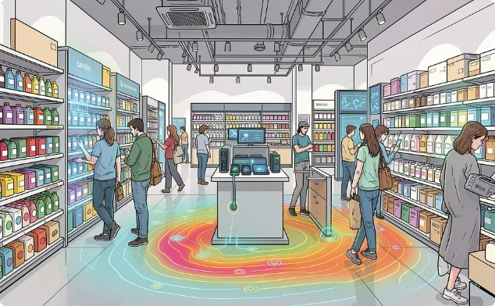
Surveillance, Autonomous Vehicles & Retail
Smart Surveillance
Autonomous Vehicles
Intelligent Retail
Facial recognition and gait analysis enhance security, automate visitor logging, and flag anomalies in real time.
Real-time environmental monitoring enables cars to identify pedestrians, read road signs, and navigate complex routes safely.
Smart inventory tracking and heat-mapping customer movement optimize store layouts, reduce theft, and personalize shopping experiences.

Slide 5
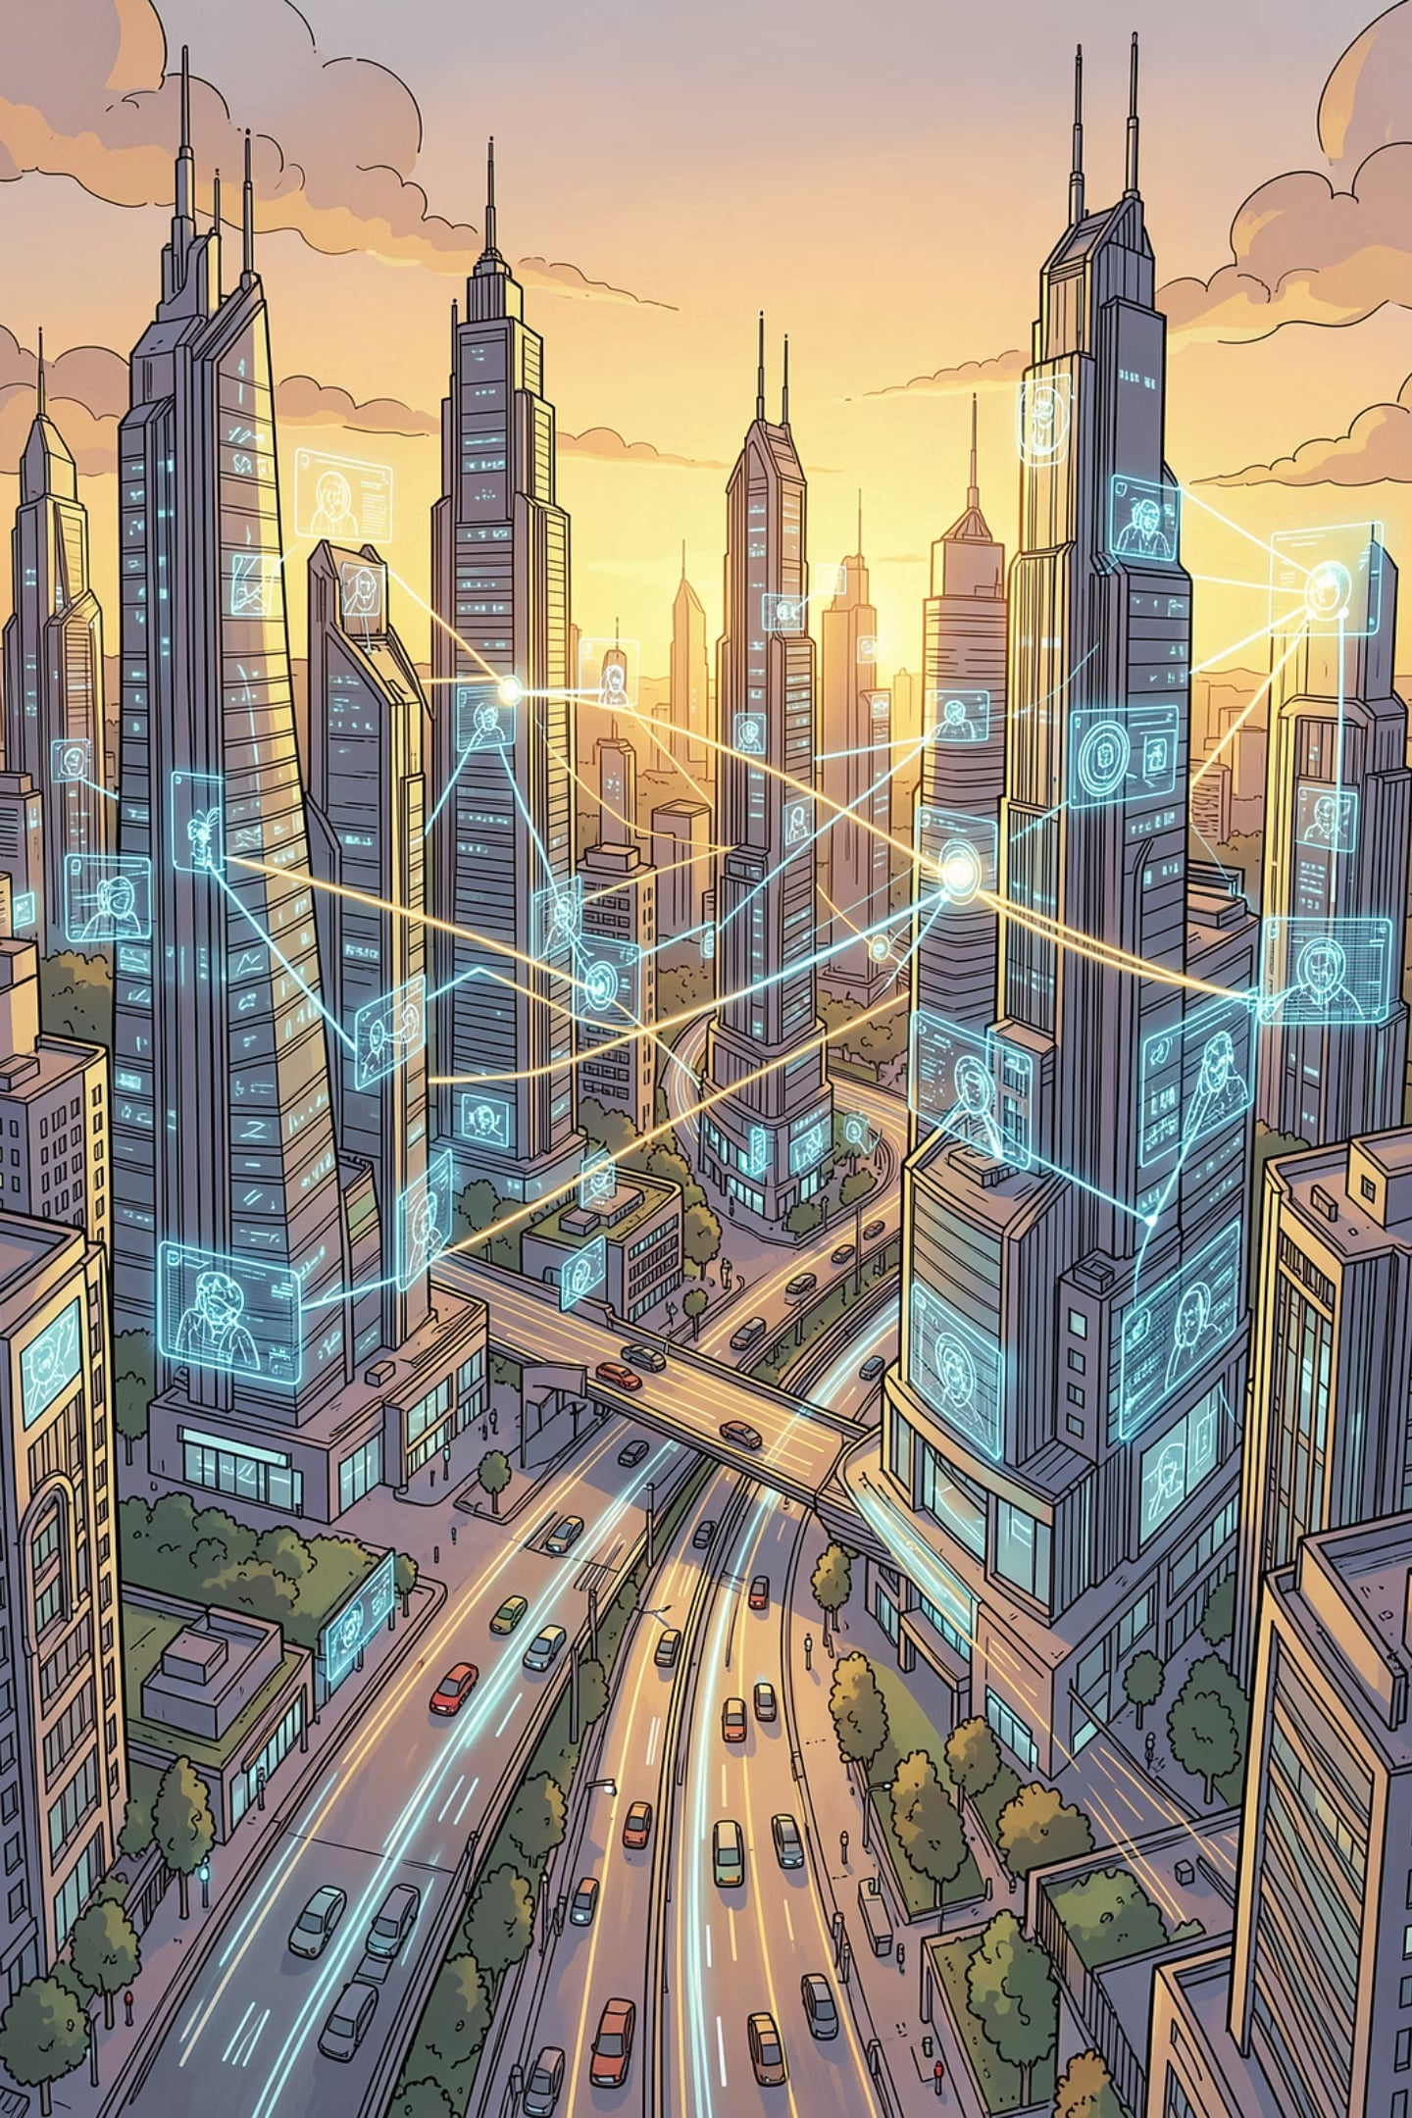
The Horizon: A World Defined by Machine Vision
Computer vision is no longer experimental — it is a pillar of modern infrastructure, from smart homes to global logistics.
Ubiquitous Vision
Ethical Responsibility
Machines interpreting visual data are revolutionizing every sector of the global economy.
Invest in robust, ethical AI frameworks to ensure vision technology benefits all of society.
The Next Frontier
From augmented reality to space exploration, machine vision will define the next century of innovation.

Slide 6
Thank You

